Slide 1

END TERM

Slide 2

Our team

Slide 3
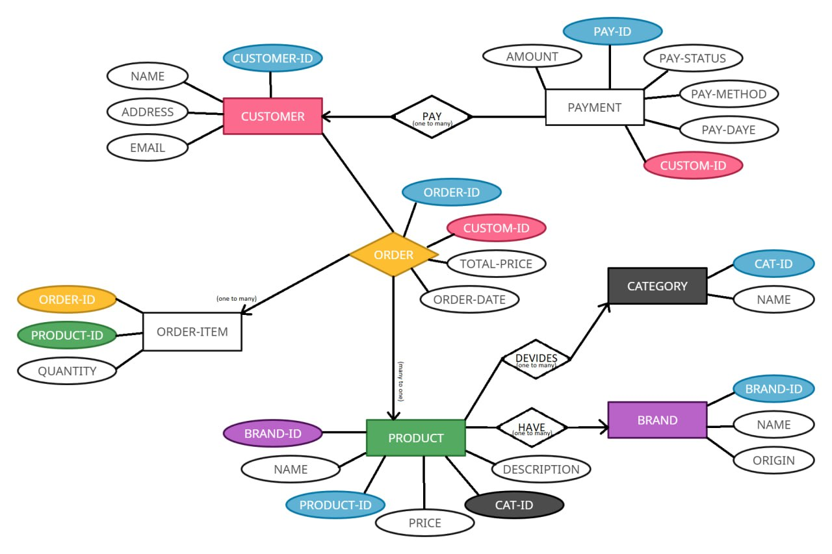
ER diagram

Slide 4
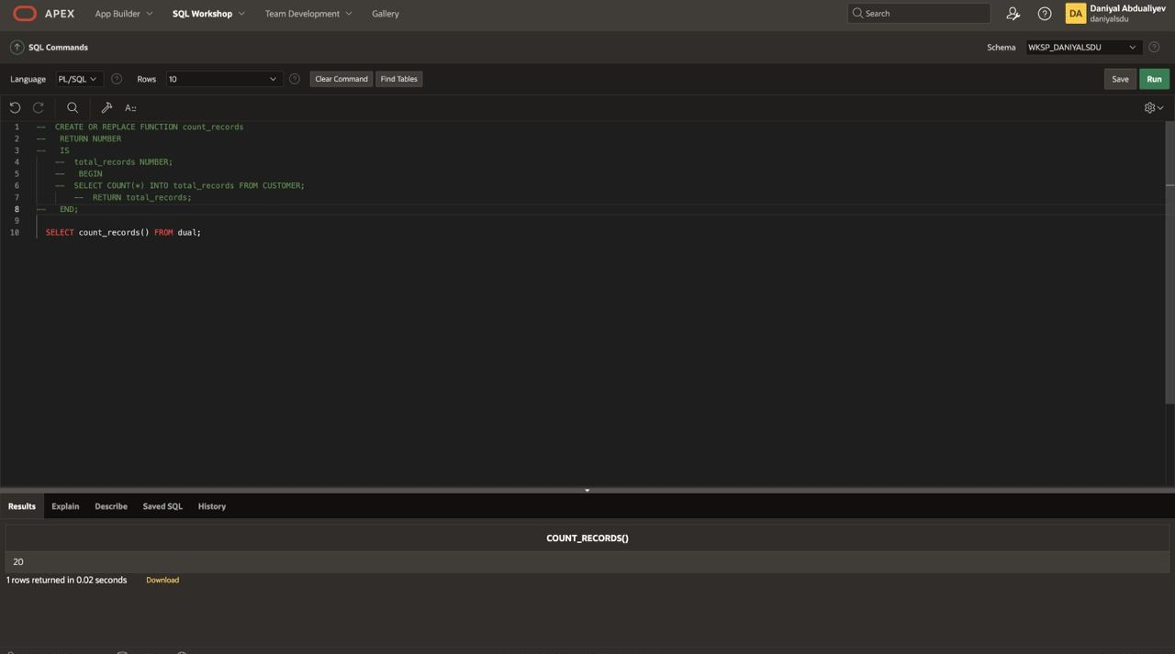
Function

Slide 5
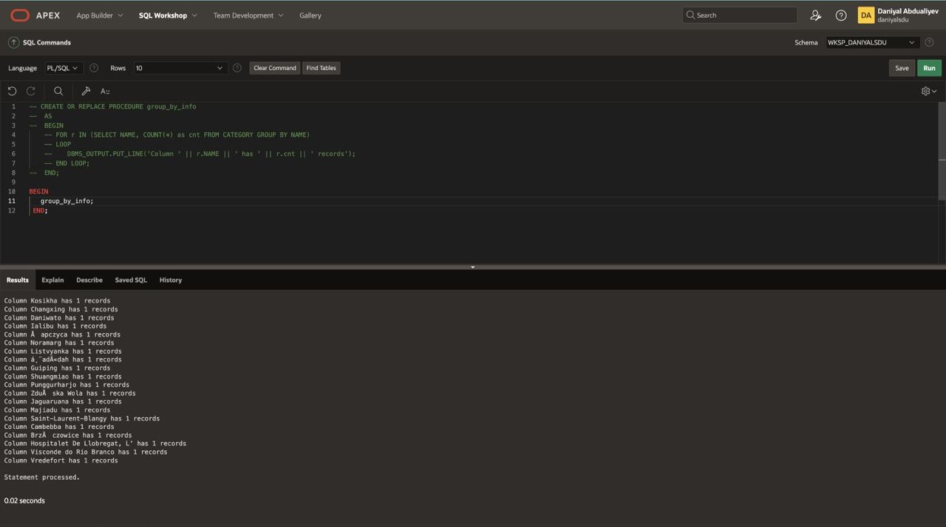
Procedure 1

Slide 6
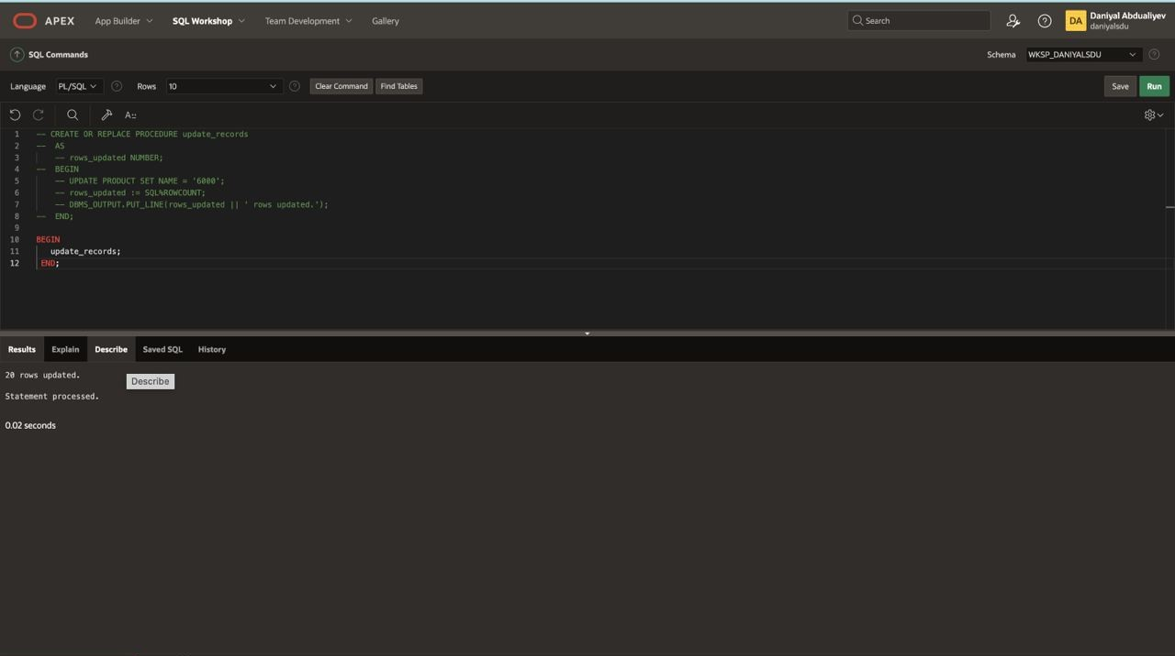
Procedure 2

Slide 7
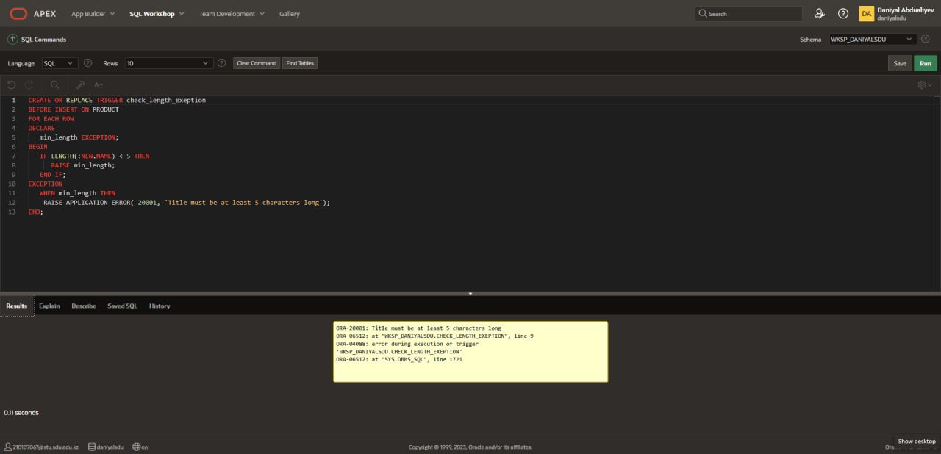
Exception

Slide 8
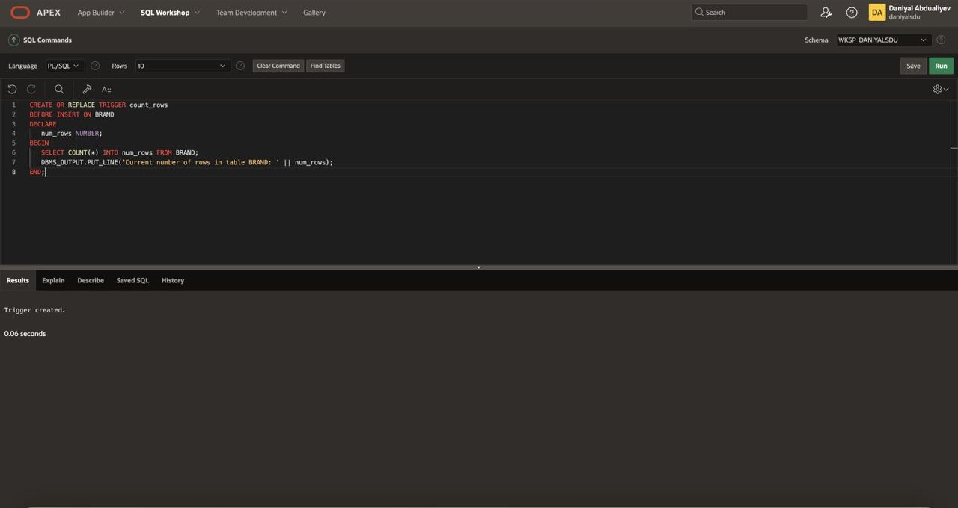
Trigger

Slide 9
Thanks for attention!

